Slide 1
Cultivation practices and utilisation of Marula (Sclerocarya birrea (L)) by smallholder farmers in dry region of Zimbabwe
By
Dr Andrew Tapiwa Kugedera

Slide 2
Introduction
Marula is one of economically important trees underutilized in Southern African countries
The tree provides important non-timber forest products (NTFPs)
NTFPs play a vital role in improving human nutrition, health and income.
Commercialisation of Marula is the best to enjoy benefits
This require sustainable domestication and cultivation practices.

Slide 3
DISTRIBUTIONMARULA TREE IN AFRICA

Slide 4
MARULA TREE

Slide 5
Aims and objectives
The aim of this study was to assess cultivation practices and utilization of Marula in dry region of Zimbabwe.
Specific objective was to:
Determine the utilisation, harvesting, stem density and economic effects of Marula on human livelihoods and country at large.

Slide 6
Theoretical Framework
The study was undertaken within the scope of sustainability science (humans vs environment).
It focused on vulnerability and robustness of human-environment systems.
Research focused on institutional frameworks which lead to sustainable management of natural resources.

Slide 7
Propagation techniques
Majority of participants (48 %) indicated that Marula is nurtured from self seeded seedling.
Farmers had limited knowledge in tree propagation especially using grafting which increase growth and fruit yield.

Slide 8
PROPAGATION USING SEED AND TRUNCHEON

Slide 9
Propagation techniques

Slide 10
Stem density in arable and non-arable

Slide 11
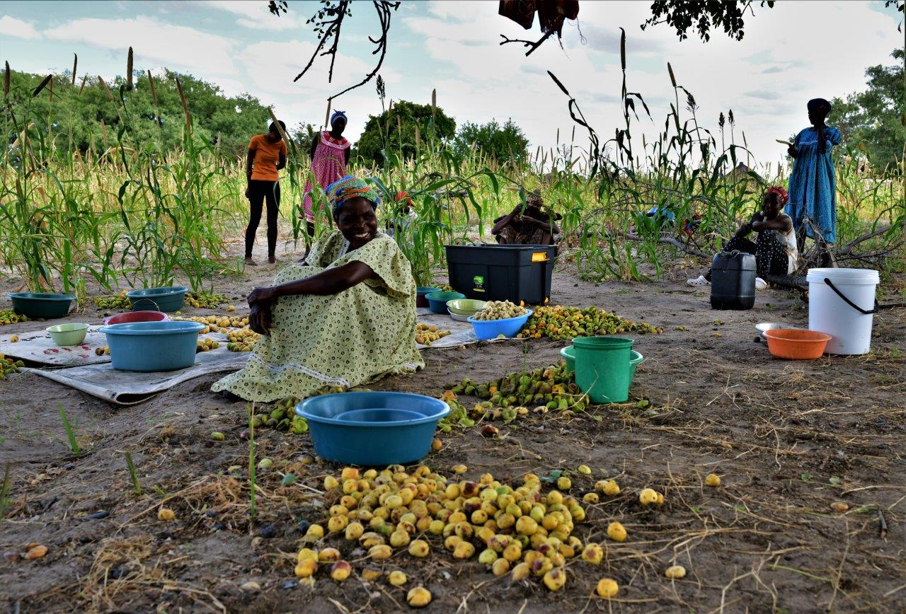
MARULA FRUITS
Fruit before ripe (green in colour and hard)
Fruit after ripe (yellow in colour and juicy)
Fruit before ripe, attached to tree
Harvested ripe Marula fruit

Slide 12
MARULA NUTS

Slide 13
Utilisation of Marula

Slide 14
Potential economic benefits of Marula
On average Marula tree yield 300 kg (72 litres juice).
A farmer is guaranteed US$60-72 per tree.
Domestication with 246 tree/ha (9 m between rows and 4.5 m within rows).
Expected yield (65 000 kg/ha) i.e. 15600 l (translates to US$15600).

Slide 15
MARULA BEER, WINE AND OTHER USES

Slide 16
MARULA CAKE AND OIL

Slide 17
TRADING POTENTIAL IN SADC COUNTRIES
Table 1: Current and potential by Product (10 SADC countries)
Product | Current trade (US$/yr) | Potential trade (US$/yr) | Current households employed (gathering only) | Potential households employed (gathering only)
Baobab | 11,203,928 | 961,358,568 | 1,165,965 | 2,640,333
Kigelia | 375,563 | 1,588,050,000 | 441,125 | 1,764,500
Marula | 425,000 | 263,001,008 | 3,475,250 | 4,436,667
Ximenia | 58,500 | 37,566,884 | 303,933 | 1,514,667
Trichelia | - | 501,665,967 | 1,144,833 | 2,289,667
Kalahari Melon | 58,500 | 21,126,226 | 745,083 | 1,483,167
Manketti | - | 19,677,684 | 197,208 | 42,597
Parinari | - | 36,516,431 | 1,774,250 | 2,365,667
TOTAL | 12,121,491 | 3,428,962,767 | 9,247,649 | 16,537,264

Slide 18
WHAT SHOULD BE DONE
Crafting of legislations (management and conservation).
Management strategies that support sustainable utilisation and marketing.
Creating public-private partnership.
Governments to come up with clear policies.

Slide 19
THE END
THANK YOU

